Slide 1


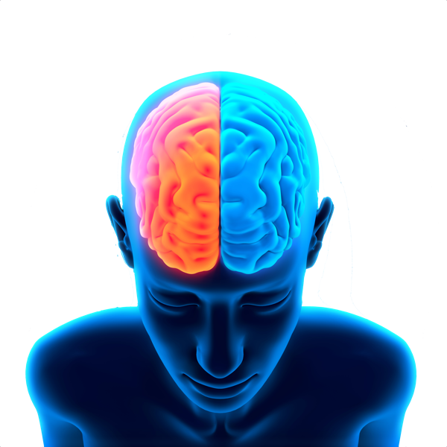
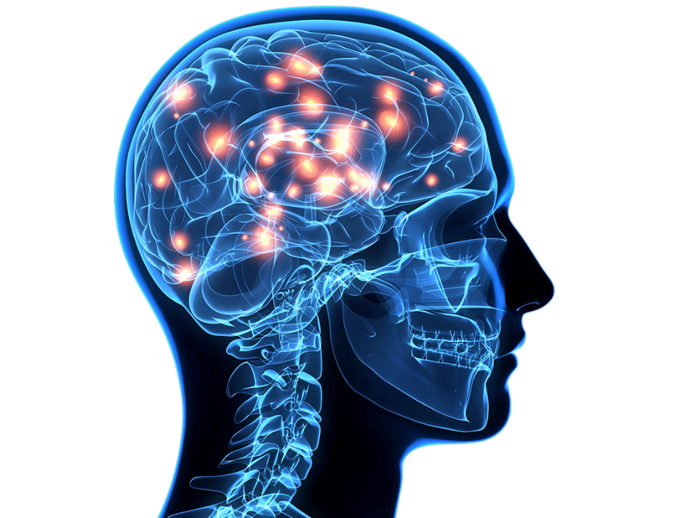
Security Aspects of neuromorphic systems
Instituto Politécnico Nacional
Centro de Investigación en Computación
Francisco Ventura Blancas
Profesor: Dr. Ricardo Barron Fernandez

Slide 2
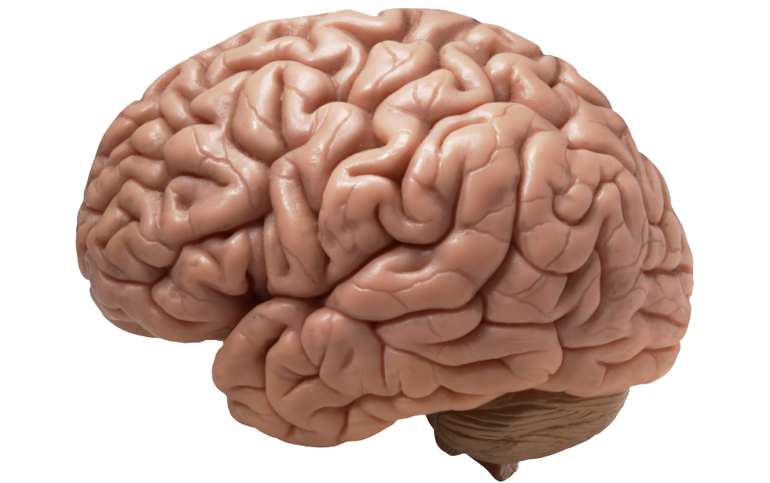
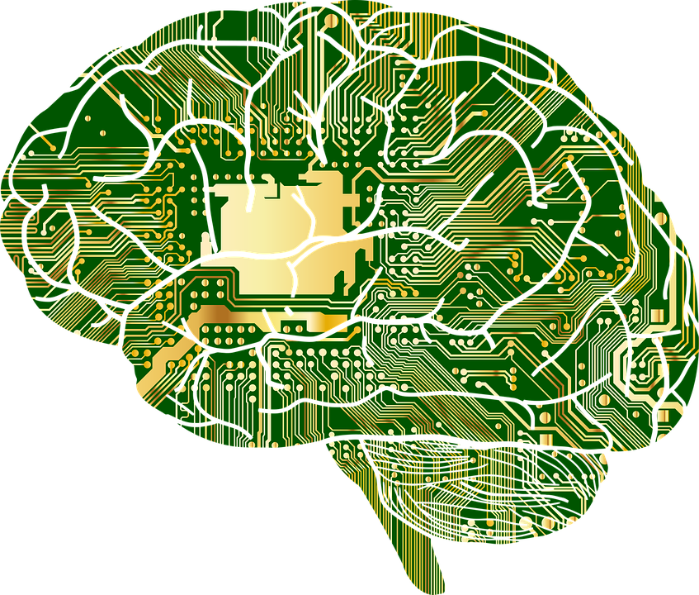
Contents
Definition
Travel from human size
Brain Research Institute MIT
Albert Einstein's brain
AI Historical context
neurotransmitters in 90 seconds
Security Goals
Cryptology and branches concept
Ciphers historical evolution
Neuronal cryptography
A System on Chip (SoC)
Neuromorphic Security

Slide 3
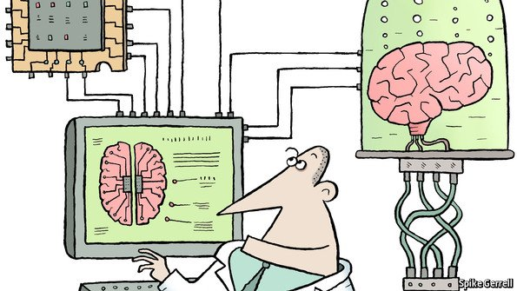
definition
Neuromorphic engineering, also known as neuromorphic computing, is the use of very-large-scale integration (VLSI) systems containing electronic analog circuits to mimic neuro-biological architectures present in the nervous system

Slide 4

Introduction

Slide 5
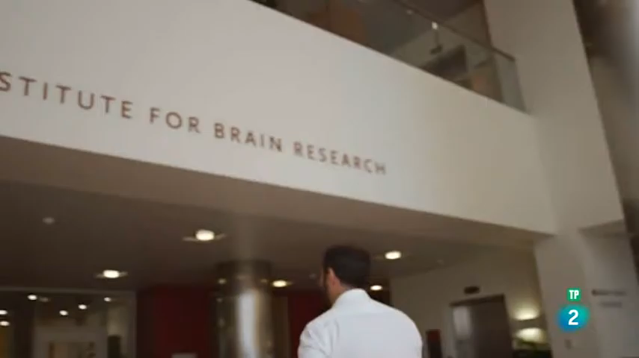

Slide 6
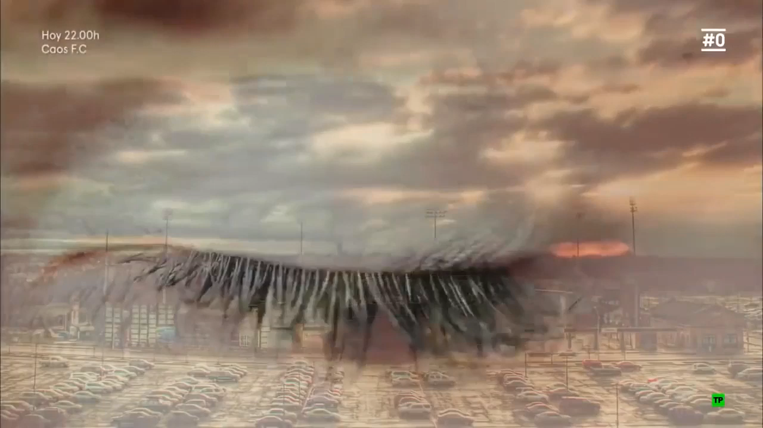

Slide 7
AI in historical context
1940s: Alan Turing first proposes “braininspired” machine intelligence
1950s: Frank Rosenblatt (Cornell) proposes “perceptron” neuron model
1960s: Marvin Minsky (MIT) argues for multi-layer (feedforward) network
1970s: AI winter
1980s: resurgence
1990s: Carver Mead (Caltech) pioneers “neuromorphic engineering”

Slide 8
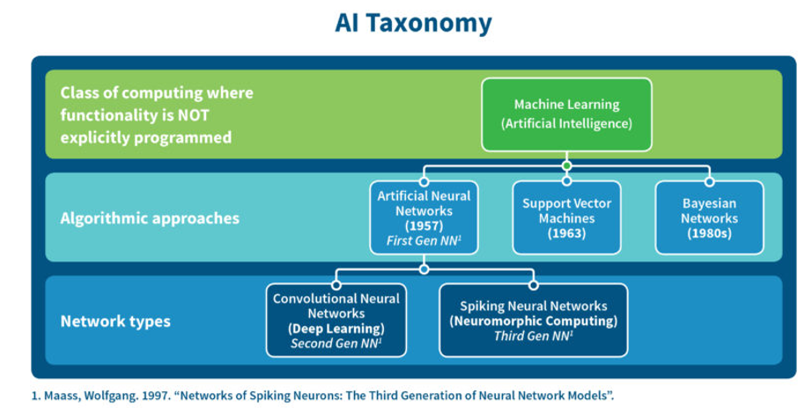
AI Taxonomy

Slide 9
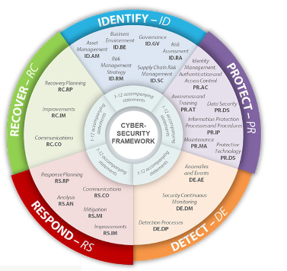
Control security
A control consists of an action, mechanism, device or technique that mitigates, removes or reduces a vulnerability to reduce risks
Prevention
Detection
Mitigation
Recovery Transfer
Preventive firewall controls controls
IDS intructions detection system
IPS instruction protection system

Slide 10
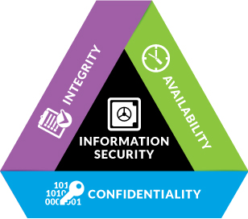
Security goals

Slide 11

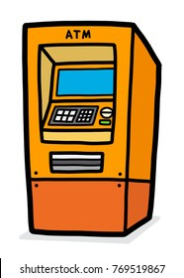

Historical evolution
Key of sector such as:
Banking
ATMs, wire transfers, electronic banking...
Communication Network
VPNs security email
E-Commerce
Mobile Phones
Pay TV and satellite TV
Digital Rights Management(DRM)...

Slide 12
Introduction
Cryptology
cryptography
Steganography
Cryptanalysis
Steganalysis

Slide 13
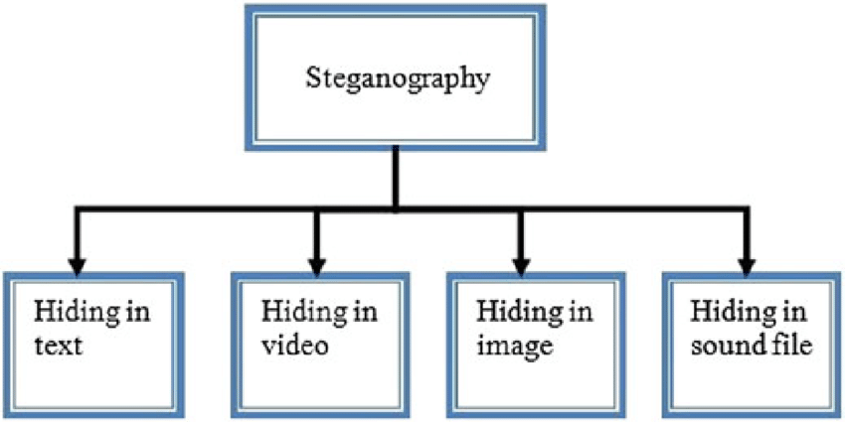
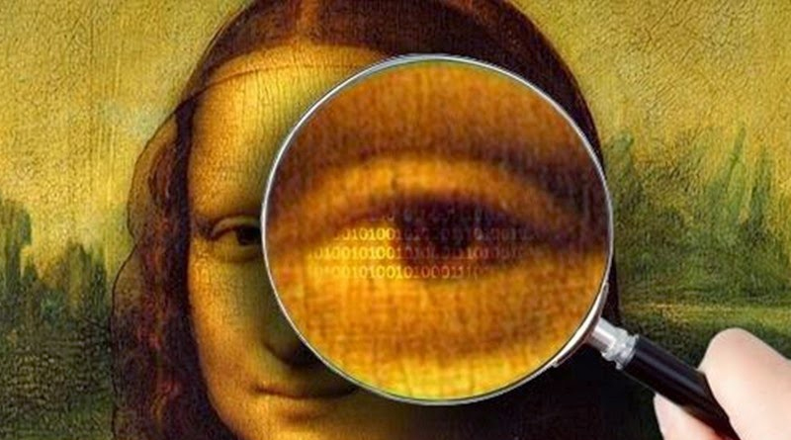
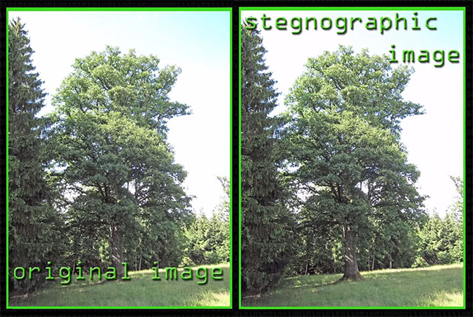
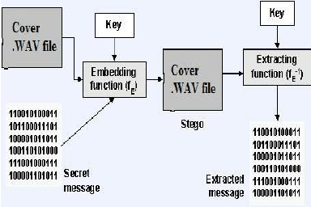

Slide 14
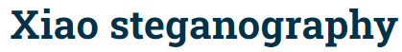
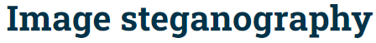

software
Xiao Steganography is free software that can be used to hide secret files in BMP images or WAV files
It also supports encryption. You can select from various algorithms like RC4, Triple DES, DES, Triple DES 112, RC2 and hashing SHA, MD4, MD2 and MD5

Slide 15
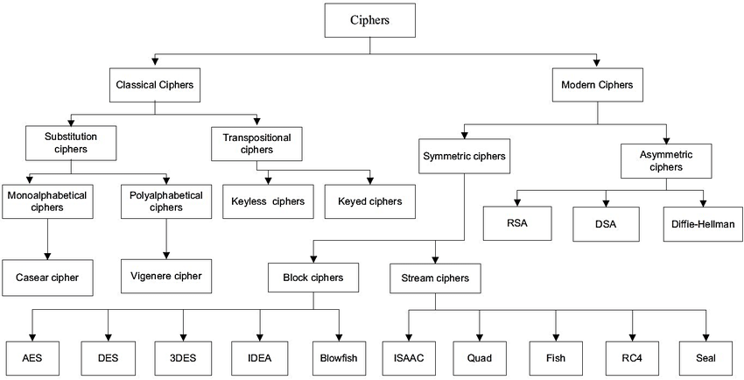
Cryptography Ciphers

Slide 16
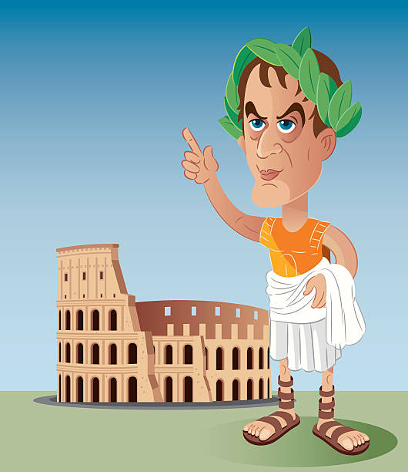
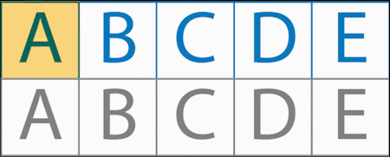
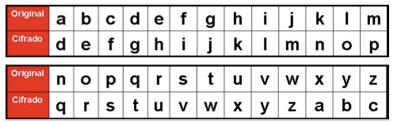
introduction
When Julius Caesar sent messages to his generals, he didn't trust his messengers. so
he replaced every A in his messages with a D.

Slide 17
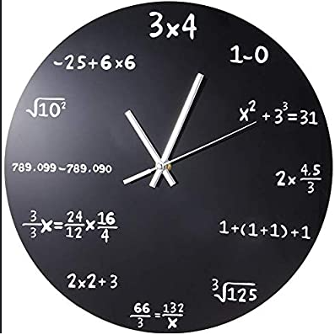
modular arithmetic
https:// github.com/franciscoventurablancas/CIC_IPN/blob/master/Criptografia/Criptografia1. ipynb

Slide 18
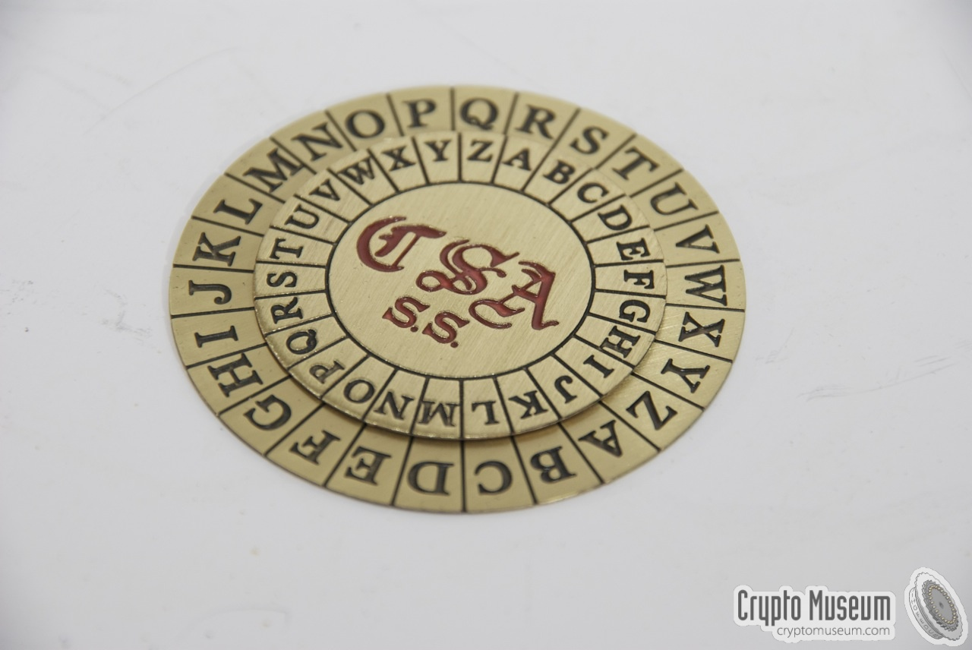
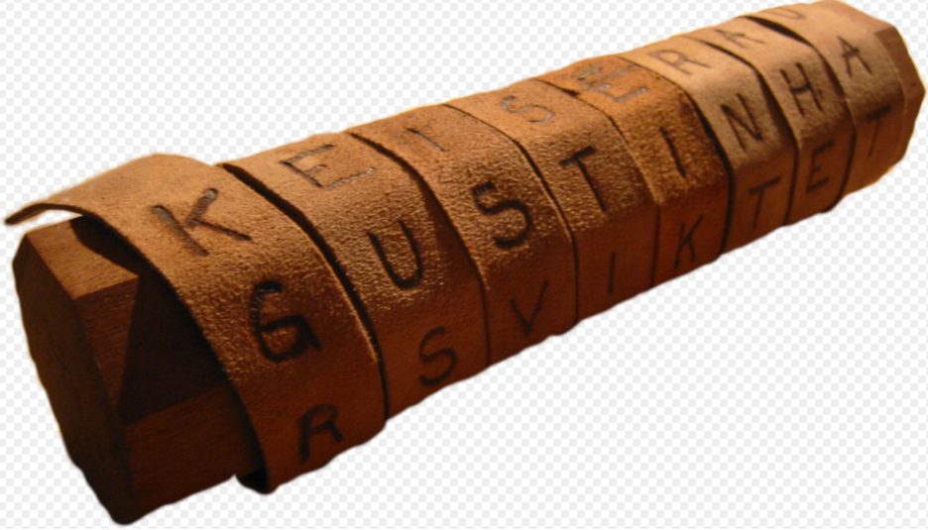
Vigenere and Scitala

Slide 19
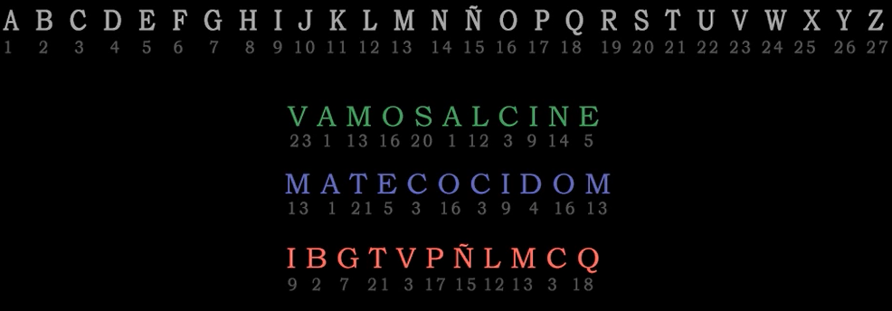
Vigenere cipher

Slide 20
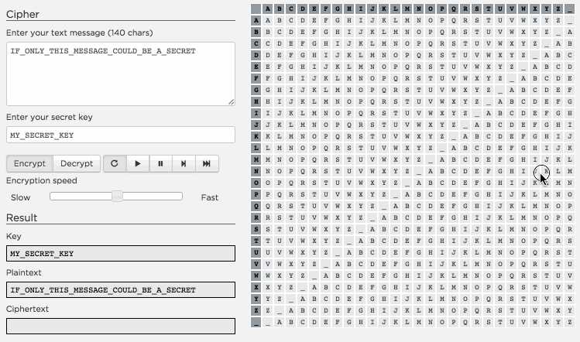
Classic cipher
Polyalphabetic substitution cipher, Kasiski test

Slide 21
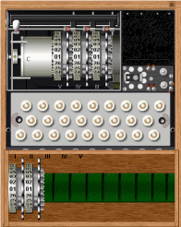
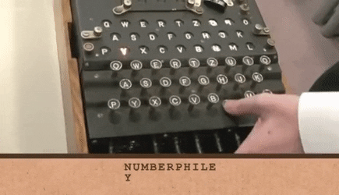
Combination cipher
Enigma

Slide 22
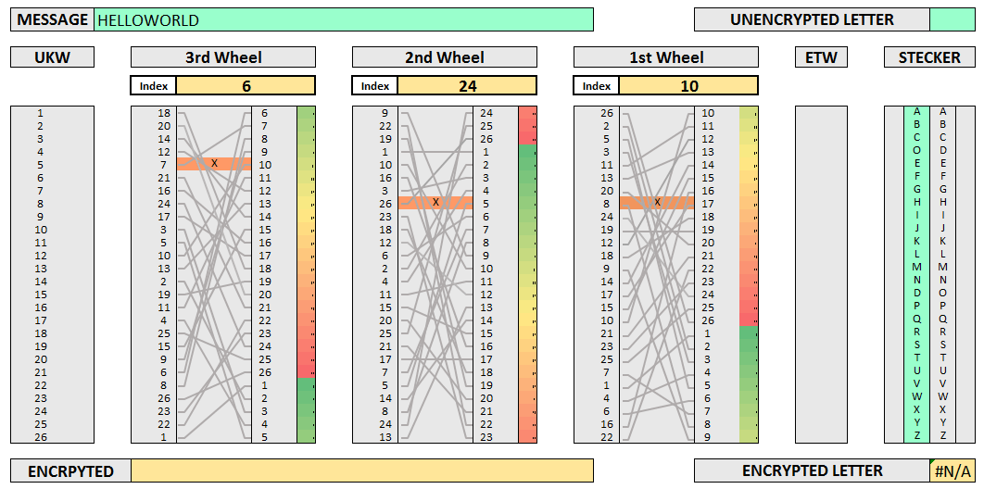
Combination cipher
Enigma

Slide 23
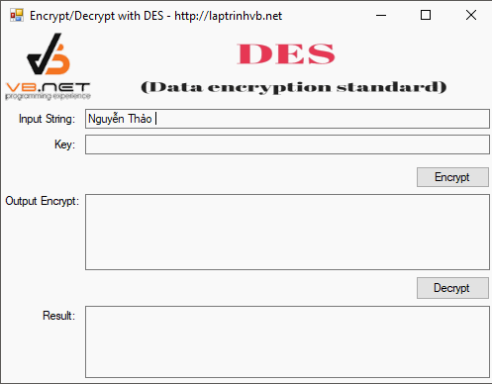
Symmetric cryptography
DES (Data Encryption Standard)
Adopted as the standard for secure
communications in the U.S in 1976
Designed by IBM in Collaboration with the NSA
unsage
key size 56 bits
Possibility to break it in 24 hours by brute force

Slide 24
Asymmetric encryption
In 1977, Rivest, Shamir and Adleman
published its asymmetric encryption
algorithm: RSA
Based on the difficulty of factoring large number
the public and private keys are obtained from
two large primes
the attacker must obtain the divisor of a number
computationally incractable

Slide 25
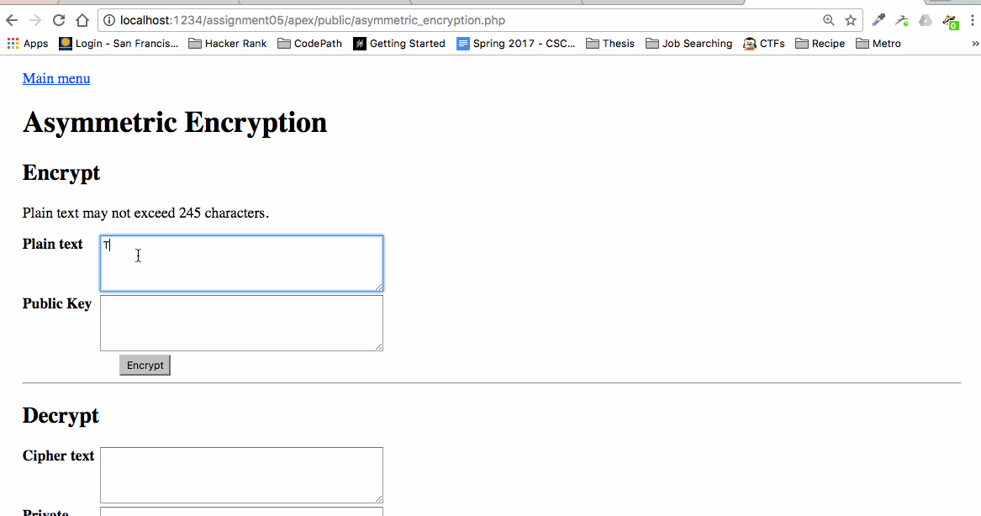

Slide 26
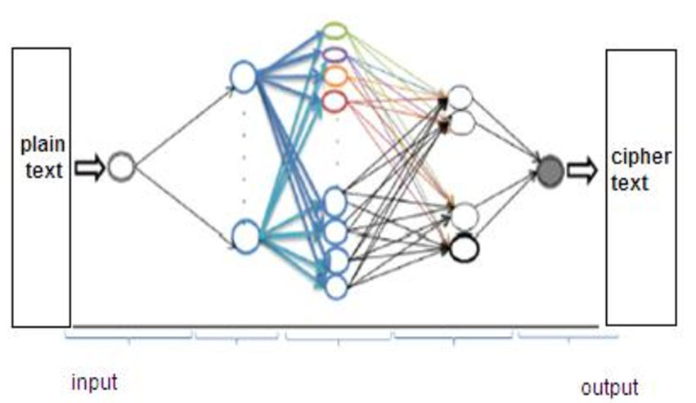
Neural cryptography is a branch of cryptography dedicated to the analysis of the application of stochastic algorithms, especially artificial neural network algorithms, for their use in encryption and cryptanalysis
What is Neuronal Cryptography?

Slide 27
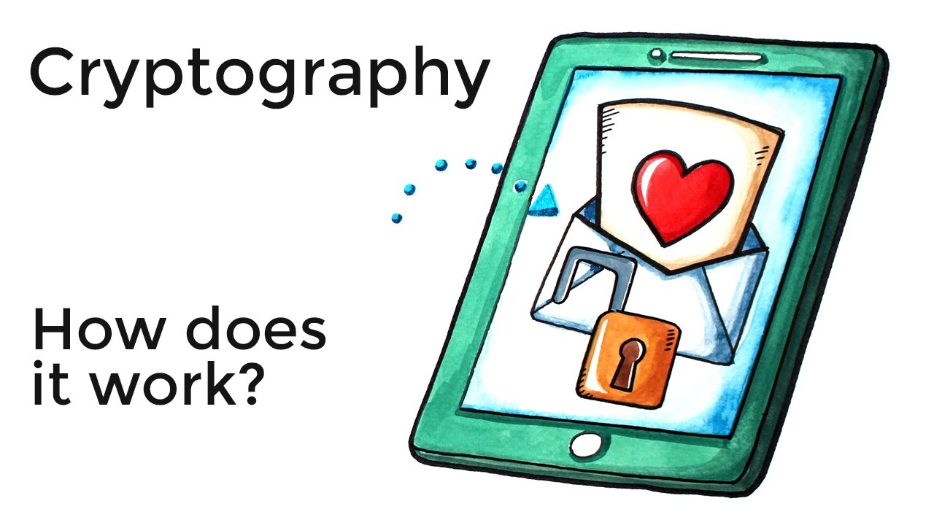
Neuromorphic computing algorithms
The applications of neural networks to cryptography, and computer security in general, can be divided into the following categories:
● Resolution of AI related problems.
● Design assistance.
● Cryptanalysis.
● Evaluation of cryptographic algorithms.
● Authentication.
● Public Key Algorithms.
● Symmetric algorithms.
● Pseudorandom Number Generators

Slide 28
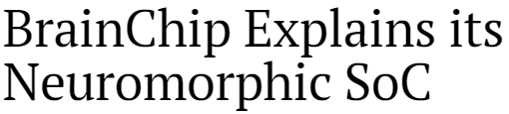
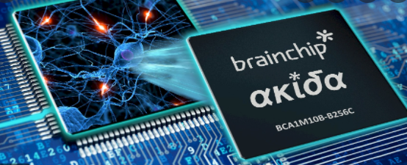
What is SoC?
A System on Chip (SoC) refers to a single-integrated circuit (chip) composed of all the components of an electronic system.
The small and efficient Akida NSoC is ideal for edge applications such as advanced driver assistance systems (ADAS), autonomous vehicles, drones, vision-guided robotics, surveillance, and machine vision systems.

Slide 29
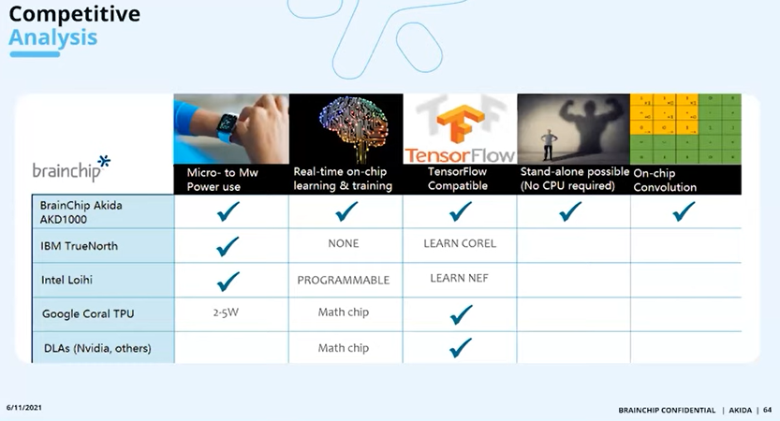
AKIDA CHIP

Slide 30
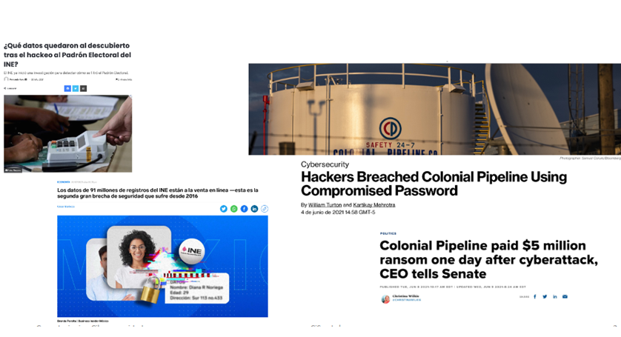
Security is important

Slide 31
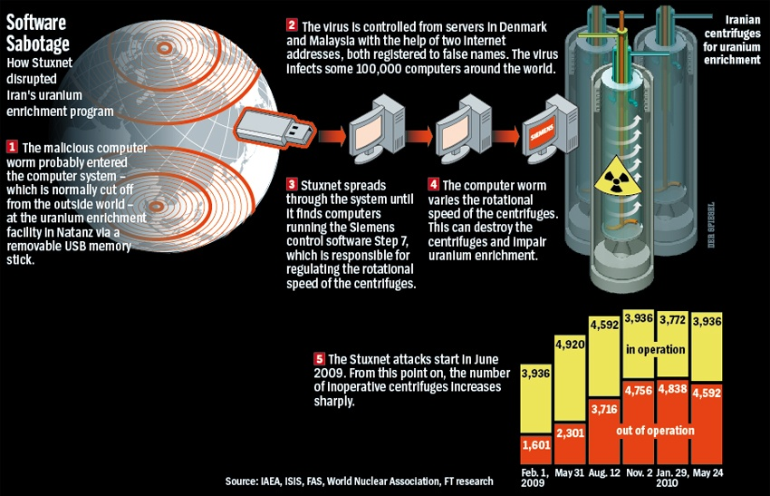
Security is important

Slide 32
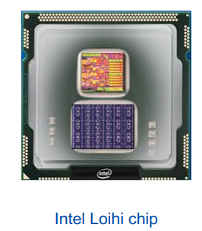
Neuromorphic computing chip could ‘smell’ explosives, narcotics, and diseases
test chip designed by Intel Labs that uses an asynchronous spiking neural network (SNN) to implement adaptive self-modifying event-driven fine-grained parallel computations used to implement learning and inference with high efficienct

Slide 33
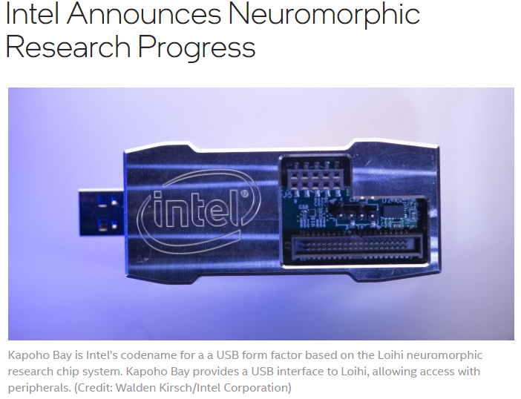
neuromorphic hardware

Slide 34
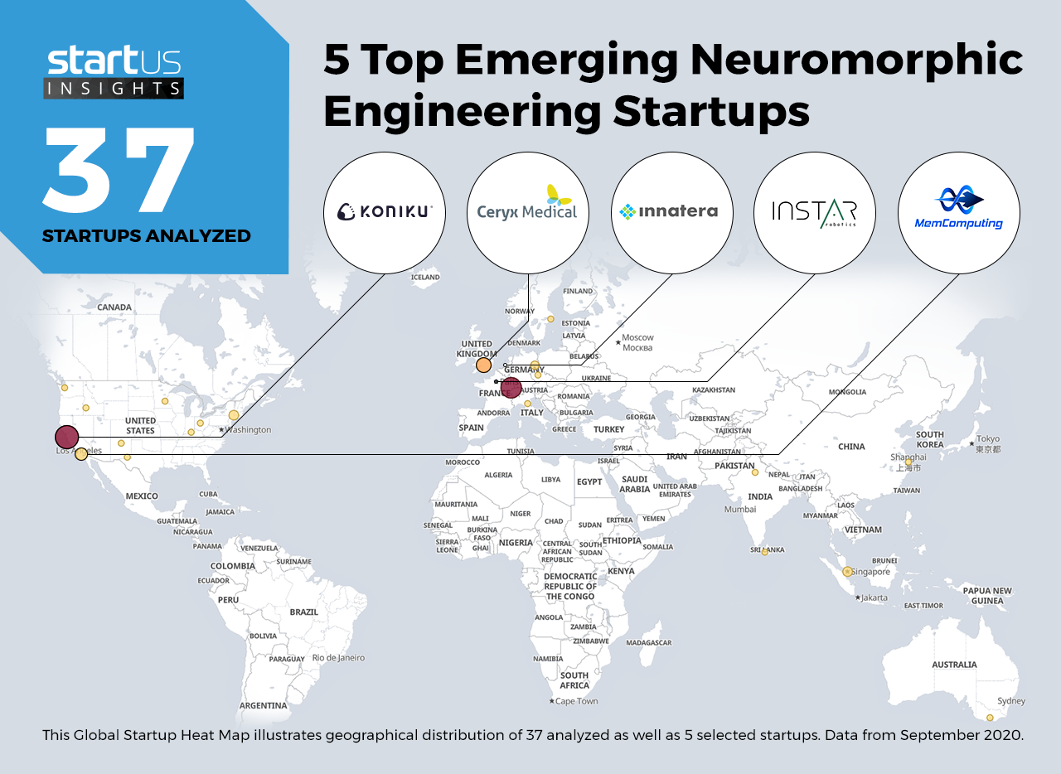

Slide 35
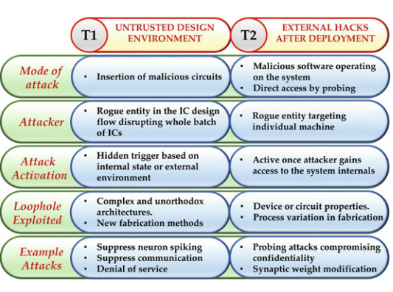
Threat Models
Security threats can be broadly classified into two lateral threat models based on
the source of security vulnerability

Slide 36
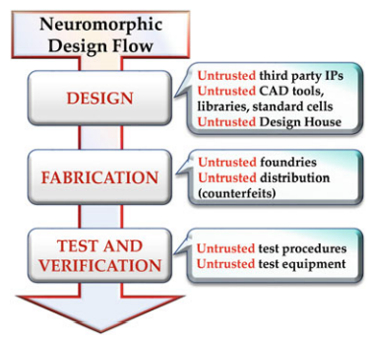
Neuromorphic Desing Flow
Neuromorphic
design flow illustrating
opportunities for hardware
Trojan insertion
Research in many of these areas for neuromorphic computing is at a very nascent stage, but the pressure to cater to a growing number of critical applications
may force premature adoption of neuromorphic systems

Slide 37

Homomorphic Encryption
Homomorphic encryption (HE) is a powerful new technique for enabling computation and collaboration on private and sensitive data through end-to-end encryption

Slide 38
references
https://newsroom.intel.com/news/intel-announces-neuromorphic-computing-research-collaborators/#gs.dua93h
Christof Paar - Understanding Cryptography_ A Textbook for Students and Practitioners-Springer 2014
Digital Media Steganography Principles, Algorithms, and Advances by Mahmoud Hassaballah
https://www.researchgate.net/publication/349307815_Understanding_Security_Threats_in_Emerging_Neuromorphic_Computing_Architecture/link/608c2fa3299bf1ad8d6b66b8/download
https://en.wikipedia.org/wiki/Neural_cryptography
https://www.researchgate.net/figure/Types-of-Cryptographic-Algorithms-1_fig2_333480277
https://www.youtube.com/watch?v=Oxt60h8YPYA&t=532s

